Slide 1
Microprocessor Architecture ECE4375 / ECE5375
Dr. Argenis Bilbao
Spring 2026

Slide 2
Presentation Outline
A deeper look into Caches and memory
  Direct mapped
  Fully associative

Slide 3
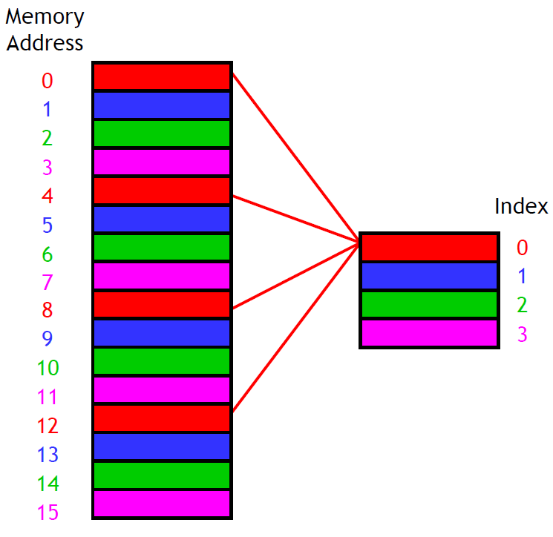
Data Location?
A direct mapped cache is the simplest approach: each main memory address maps to exactly one cache block.
For example, on the right is a
16-byte main memory and a
4-byte cache (four 1-byte blocks).
Memory locations 0, 4, 8 and 12
all map to cache block 0.
Addresses 1, 5, 9 and 13 map to
cache block 1, etc.
How can we compute this
mapping?

Slide 4
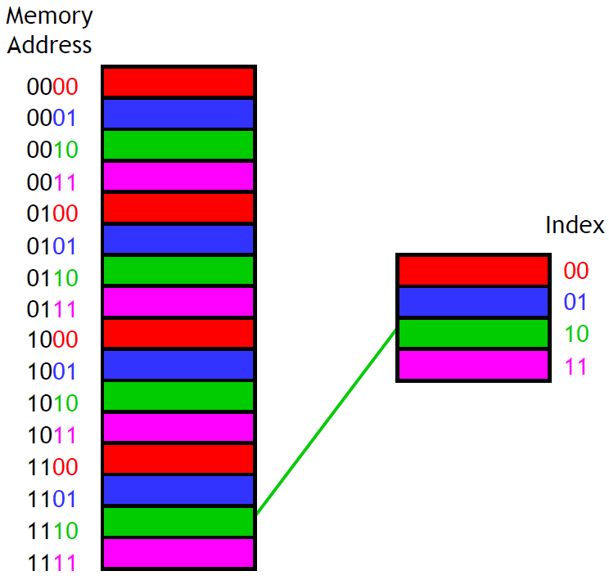
Look no Further Than The Least-Significant Bits
An equivalent way to find the placement of a memory address in the cache is to look at the least significant k bits of the address.
With our four-byte cache
we would inspect the two
least significant bits of
our memory addresses.
Again, you can see that
address 14 (1110 in binary)
maps to cache block 2
(10 in binary).
Taking the least k bits of
a binary value is the same
as computing that value
mod 2^{k}.

Slide 5
How Can We Find Data?
The second question was how to determine whether or not the data we’re interested in is already stored in the cache.
If we want to read memory
address i, we can use the
mod trick to determine
which cache block would
contain i.
But other addresses might
also map to the same cache
block. How can we
distinguish between them?
For instance, cache block
2 could contain data from
addresses 2, 6, 10 or 14.

Slide 6
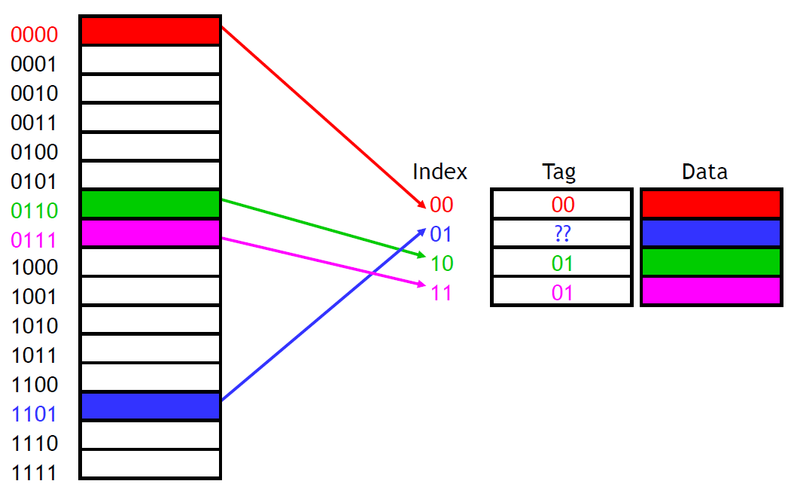
We need Tags!
We need to add tags to the cache, which supply the rest of the address bits to let us distinguish between different memory locations that map to the same cache block.

Slide 7
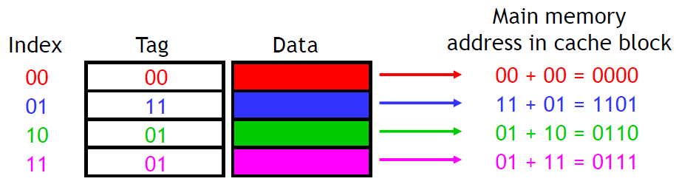
We need Tags!
Now we can tell exactly which addresses of main memory are stored in the cache, by concatenating the cache block tags with the block indices.

Slide 8
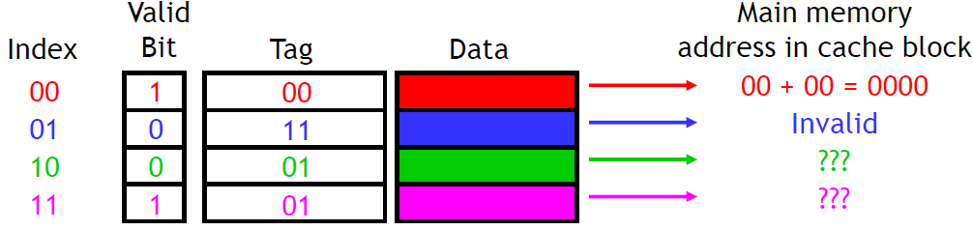
The Valid Bit
When started, the cache is empty and does not contain valid data.
We should account for this by adding a valid bit for each cache block.
When the system is initialized, all the valid bits are set to 0.
When data is loaded into a particular cache block, the corresponding valid bit is set to 1.
So, the cache contains more than just copies of the data in memory; it also has bits to help us find data within the cache and verify its validity.

Slide 9
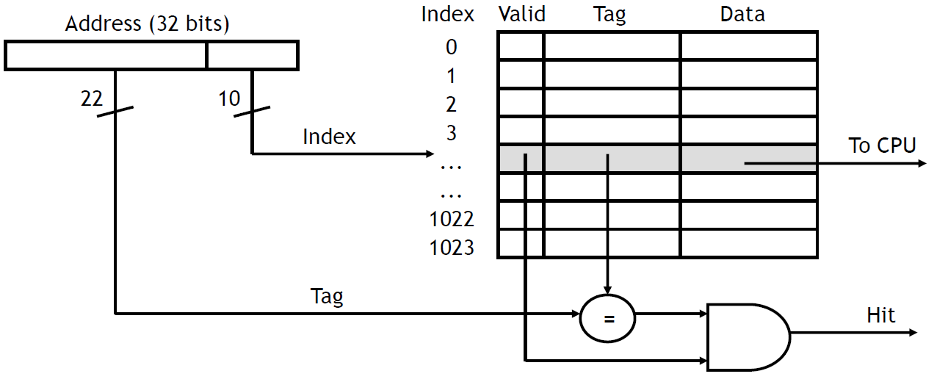
What Happens On a Cache Hit?
When the CPU tries to read from memory, the address will be sent to a cache controller.
  The lowest k bits of the address will index a block in the cache.
  If the block is valid and the tag matches the upper (m-k) bits of the m-bit address, then that data will be sent to the CPU.
Here is a diagram of a 32-bit memory address and a 210-byte cache.

Slide 10
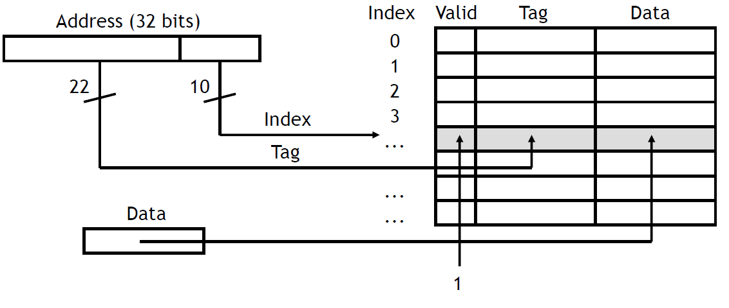
Block Loading
After data is read from main memory, putting a copy of that data into the cache is straight forward.
  The lowest k bits of the address specify a cache block.
  The upper (m-k) address bits are stored in the block’s tag field.
  The data from main memory is stored in the block’s data field.
  The valid bit is set to 1

Slide 11
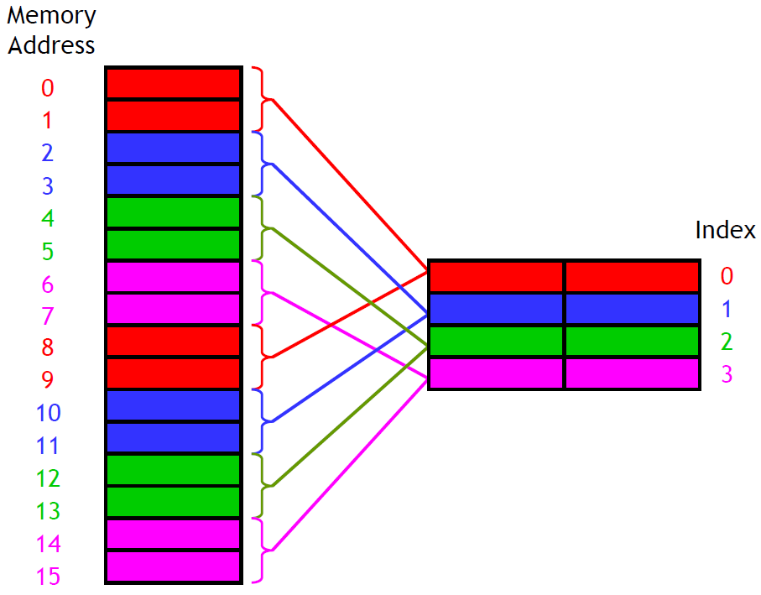
What About Spatial Locality?
What we can do is make the cache block size larger than one byte.
Here we use two-byte blocks, so we can load the cache with two bytes at a time.
If we read from address
12, the data in addresses
12 and 13 would both be
copied to cache block 2.

Slide 12
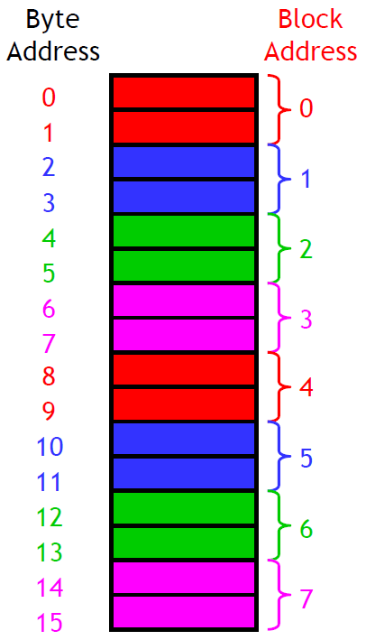
The Need For Block Addresses Arise!
Now how can we figure out where data should be placed in the cache?
It’s time for block addresses! If the cache block size is 2^{n} bytes, we can conceptually split the main memory into 2^{n}-byte
chunks too.
To determine the block address of a byte
address i, you can do the integer division
i / 2^{n}
Our example has two-byte cache blocks, so
we can think of a 16-byte main memory as
an “8-block” main memory instead.
For instance, memory addresses 12 and 13
both correspond to block address 6, since 12 / 2 = 6
and 13 / 2 = 6.

Slide 13
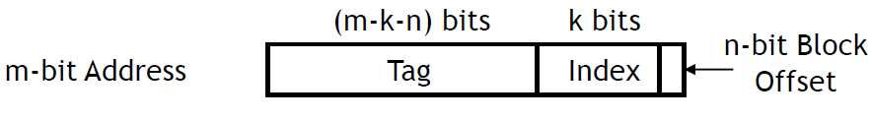
Looking for Data In a Multi-Byte Block
Let’s say we have a cache with 2^{k} blocks, each containing 2^{n} bytes.
We can determine where a byte of data belongs in this cache by looking at its address in main memory.
  k bits of the address will select one of the 2^{k} cache blocks.
  The lowest n bits are now a block offset that decides which of the 2^{n} bytes in the cache block will store the data.

Slide 14
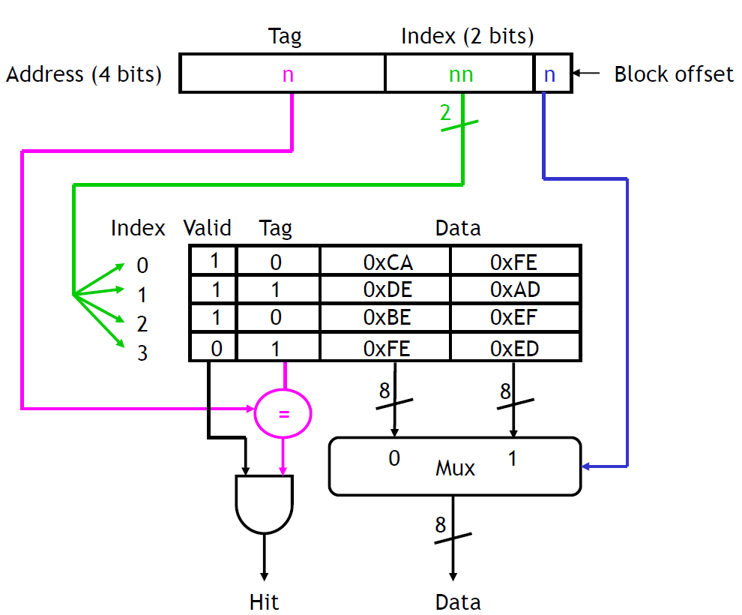
A Quick Exercise
For the addresses below, what byte is read from the cache (or is there a miss)?
1010, 1110, 0001, 1101

Slide 15
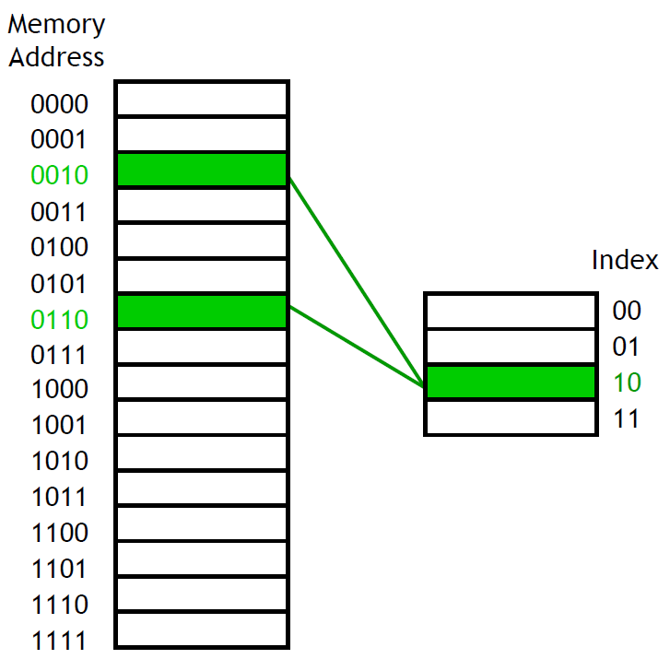
Disadvantage of Direct Mapping Caches
The direct-mapped cache is easy: Indices and offsets can be computed with bit operators or simple arithmetic, because each memory address belongs in exactly one block.
But what happens if a
program uses addresses
2, 6, 2, 6, 2, …? Collisions!

Slide 16
Fully Associative Cache
A fully associative cache permits data to be stored in any cache block, instead of forcing each memory address into one particular block.
  When data is fetched from memory, it can be placed in any unused block of the cache.
  This way we’ll never have a conflict between two or more memory addresses which map to a single cache block.
In the previous example, we might put memory address 2 in cache block 2, and address 6 in block 3. Then subsequent repeated accesses to 2 and 6 would all be hits instead of misses.
If all the blocks are already in use, it’s usually best to replace the least recently used one, assuming that if it hasn’t used it in a while, it won’t be needed again anytime soon.

Slide 17
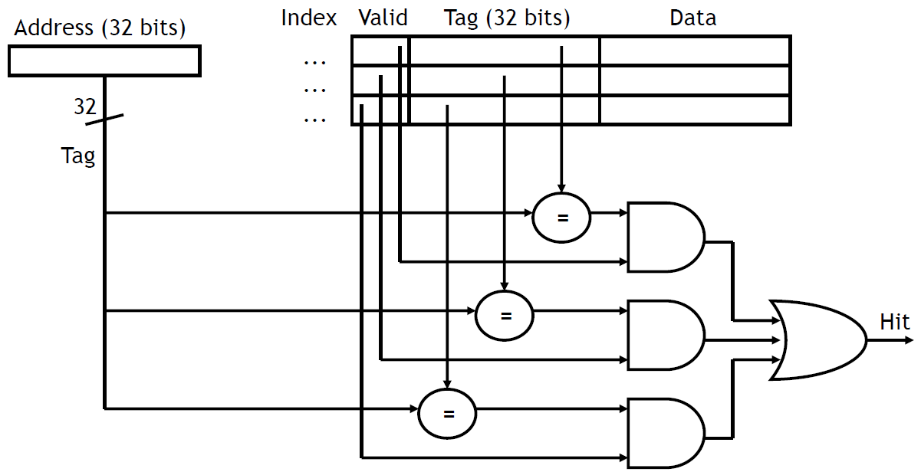
Pay The Price?
However, a fully associative cache is expensive to implement.
  Because there is no index field in the address anymore, the entire address must be used as the tag, increasing the total cache size.
  Data could be anywhere in the cache, so we must check the tag of every cache block. That’s a lot of comparators!

Slide 18
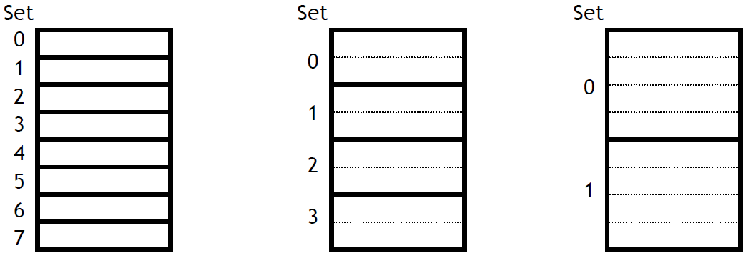
Set Associative Cache
An intermediate possibility is a set-associative cache.
  The cache is divided into groups of blocks, called sets.
  Each memory address maps to exactly one set in the cache, but data may be placed in any block within that set.
If each set has 2^{x} blocks, the cache is an 2^{x}-way associative cache.
Here are several possible organizations of an eight-block cache.
1-way associativity
8 sets, 1 block each
2-way associativity
4 sets, 2 blocks each
4-way associativity
2 sets, 4 block each

Slide 19
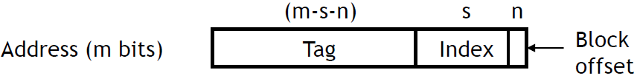
Locating a Set Associative Block
We can determine where a memory address belongs in an associative cache in a similar way as before.
If a cache has 2^{s} sets and each block has 2^{n} bytes, the memory address can be partitioned as follows.
Our arithmetic computations now compute a set index, to select a set within the cache instead of an individual block.
Block Offset = Memory Address mod 2^{n}
Block Address = Memory Address / 2^{n}
Set Index = Block Address mod 2^{s}

Slide 20
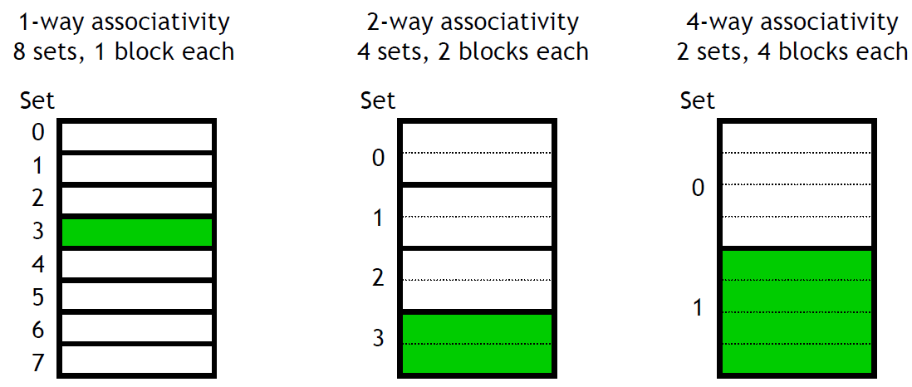
Locating a Set Associative Block
Where would data from memory byte address 6195d be placed, assuming the eight-block cache designs below, with 16 bytes per block?
6195d in binary is 0001 1000 0011 0011.
Each block has 16 bytes, so the lowest 4 bits are the block offset.
For the 1-way cache, the next three bits (011) are the set index.
For the 2-way cache, the next two bits (11) are the set index.
For the 4-way cache, the next one bit (1) is the set index.
The data may go in any block, shown in green, within the correct set.

Slide 21
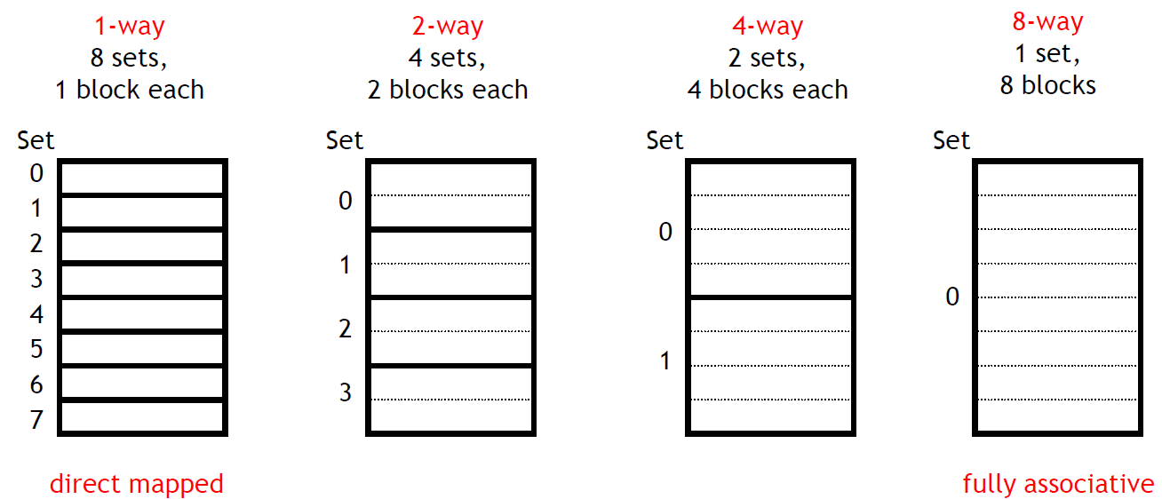
Set Associative Caches Are Just An Idea
By now you may have noticed the 1-way set associative cache is the same as a direct-mapped cache.
Similarly, if a cache has 2^{k} blocks, a 2^{k}-way set associative cache would be the same as a fully-associative cache.

Slide 22
Summary
Larger block sizes can take advantage of spatial locality by loading data from not just one address, but also nearby addresses, into the cache.
Set-Associative caches assign each memory address to a particular set within the cache, but not to any specific block within that set.
  Set sizes range from 1 (direct-mapped) to 2^{k}(fully associative).
  Larger sets and higher associativity lead to fewer cache conflicts and lower miss rates, but they also increase the hardware cost.
  In practice, 2-way through 16-way set-associative caches strike a good balance between lower miss rates and higher costs.

Slide 23
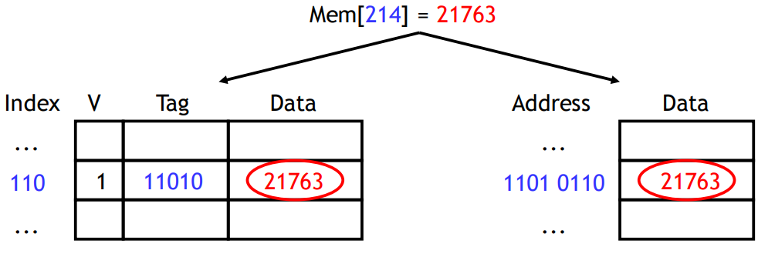
What About Cache Coherence?
Cache coherence refers to the consistency or discrepancy of the cached value and the value located in main memory or within other cache levels.
Cache coherence problems will arise when the CPU modifies (writes) a value in the cache.
At some point we need to write the contents of the cache back to main memory.
A write-through cache forces all writes to update both the cache and the main memory.
Simple to implement and keeps cache and memory consistent.
Wastes memory bandwidth.

Slide 24
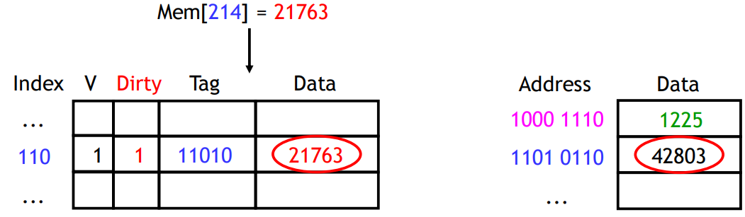
Write-back Caches
In a write-back cache, the memory is not updated until the cache block needs to be replaced (e.g., when loading data into a full cache set).
For example, we might write some data to the cache at first, leaving it inconsistent with the main memory as shown before.
  The cache block is marked “dirty” to indicate this inconsistency.
Subsequent reads to the same memory address?
Multiple writes to same block?

Slide 25
Write-back Caches
The advantage of write-back caches is that not all write operations need to access main memory, as it does with write-through caches.
  If a single address is frequently written to, then it doesn’t pay to keep writing that data through to main memory.
  If several bytes within the same cache block are modified, they will only force one memory write operation at write-back time.

Slide 26
Write Misses
A second scenario is if we try to write to an address that is not already contained in the cache; this is called a write miss.
Let’s say we want to store 21763 into Mem[1101 0110] but we find that address is not currently in the cache.
When we update Mem[1101 0110], should we also load it into the cache?
We have two choices on a write miss: Make room for new data or don’t.

Slide 27
Write Around
With a write around policy, the write operation goes directly to main memory without affecting the cache.
This is good when data is written but not immediately used again, in which case there’s no point to load it into the cache yet.
Example
For(int i = 0; i < SIZE; i++)
a[i] = i;
Makes more sense for write-though caches.

Slide 28
Allocate on Write
An allocate on write strategy would load the newly written data into the cache.
If that data is needed again soon, it will be available in the cache.
Makes more sense for write-back caches.

Slide 29
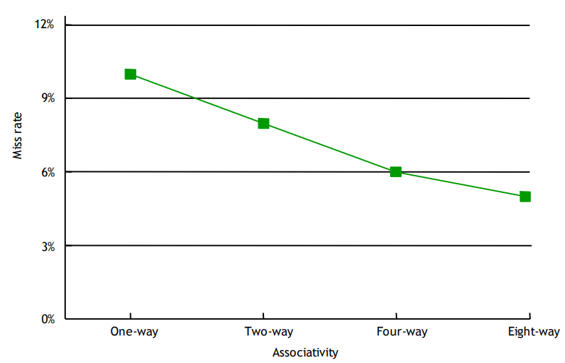
Performance Comparison

Slide 30
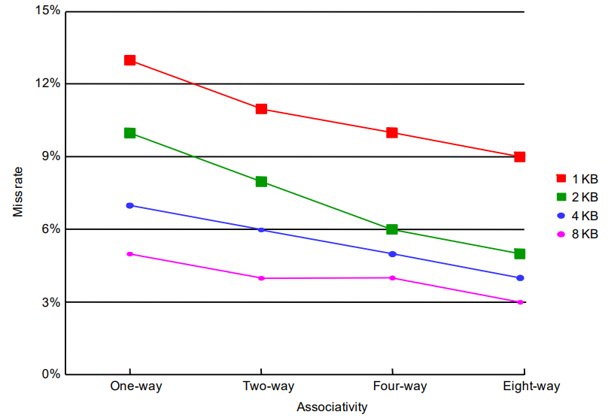
Performance Comparison

Slide 31
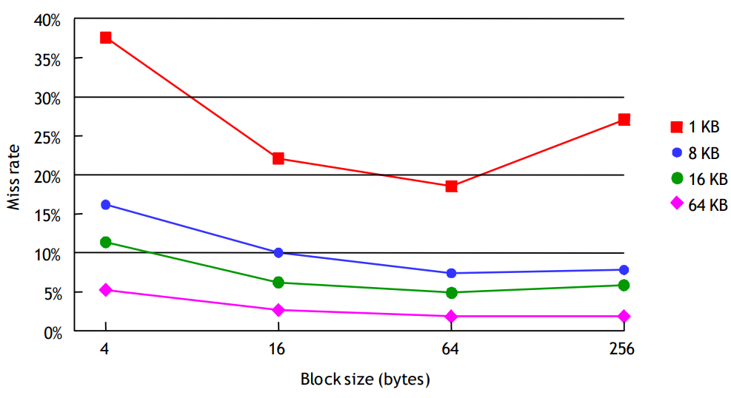
Performance Comparison

Slide 32
Sources
http://www.eecs.harvard.edu/cs146-246/
Assigned Textbook
https://sites.pitt.edu/~juy9/
https://en.wikipedia.org/wiki/Cache_coherence

